Slide 1
Making Today’s Internet Faster
(Automatic Transition To Peer-to-Peer Download)

Slide 2
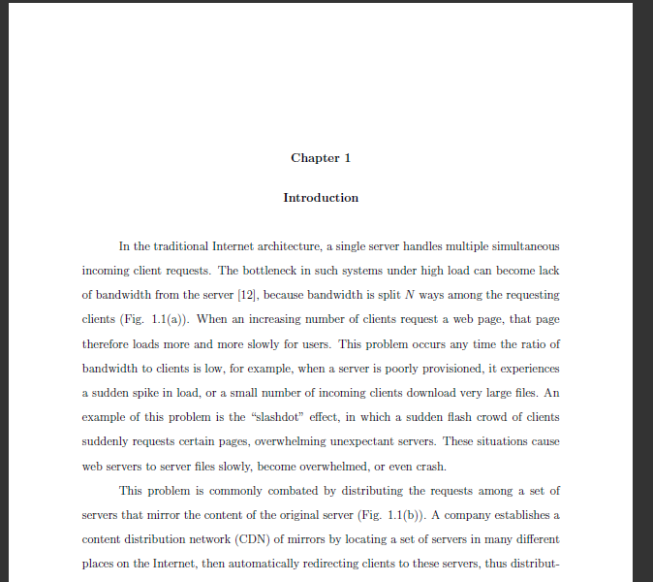
Thesis

Slide 3
Thanks!
Family
Teachers
wE\=f P'P= \ROVIDE A U966554F545DS6TFDV87654536:01 PM 4/5/20102 098YH6Ya 1W N.I
Notes:
This is your fault.
Defense dream.

Slide 4
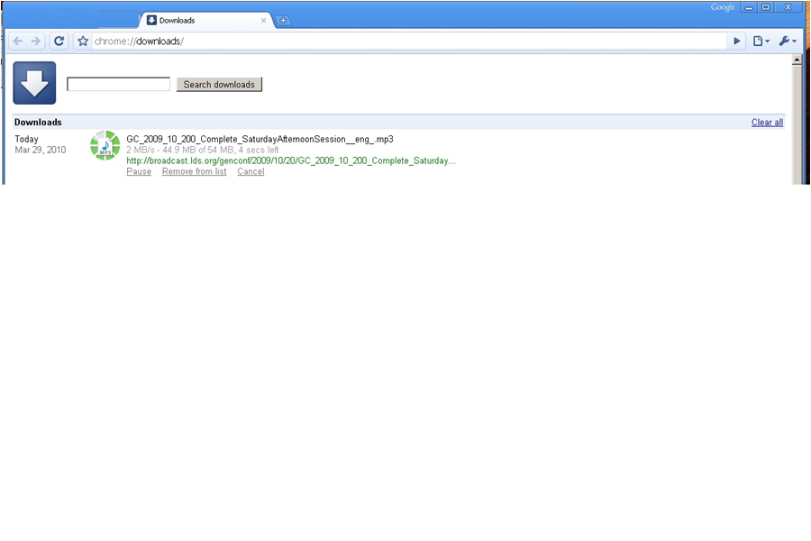
Fast download

Slide 5

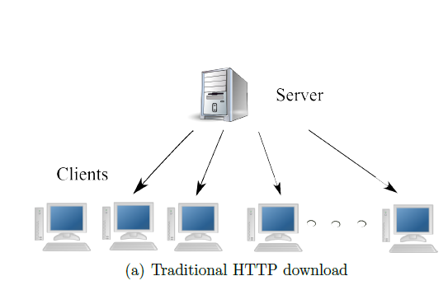
Slow downloads
Frustration
Wasted bandwidth
Under provisioned.
Too far.
Flash flood.
Notes:
Lodo:
Add a graph of network speed increasing so slowly compared to processors and disks (?) (?)

Slide 6
Your options
Hit reload.
Wait around.
Try somewhere else.
Download Manager.
Add a local caching proxy.
Add local bandwidth.
Beg the server to change how they serve the file.

Slide 7

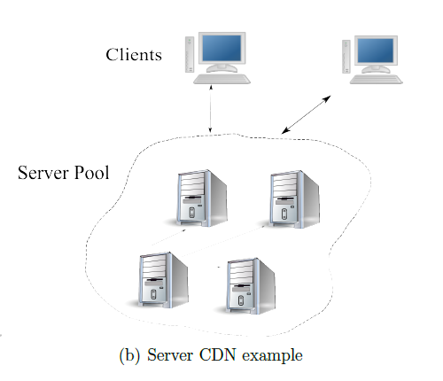
Server options
Buy more bandwidth.
Move.
Buy more servers/rent a CDN
Popular
Turn to P2P

Slide 8

CDN can fail
Overloaded.
Not close enough.
Expensive.

Slide 9

Turn to P2P
BitTorrent
Create + host BitTorrent File.
Run a tracker.
Peers download and share blocks (efficiently).
Works well for large popular files.
“When I created BitTorrent in 2001, my mission was to solve the problem every website has when distributing large, popular files” – Bram Cohen

Slide 10
BitTorrent fails
Server side.
Per File
Have to provide traditional anyway.
Lack of clients.
Stigma.
Extra maintenance.
Large Files.
Unknown demand.

Slide 11
BitTorrent fails
Clients
Extra setup/time per file.
Small files
Techno intelligencia
Non integrated.
Manual.
Not HTTP optimized.
It should be ignored speed-wise
Duplicate
Costs time
Warmup phase.
Transition.
Not available.
Notes:
Normal people do not use BitTorrent. Not useful to them.

Slide 12
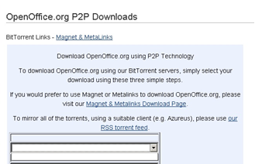
BitTorrent can Fail
Not enough seeds.
Closed ports.
Tracker
Extra files.
Users don’t have client installed (chicken/egg).
Clients aren’t configured to use HTTP well.
Notes:
The more general problem is that when downloading typical files from the Internet, Bittorrent cannot come to your aid.

Slide 13
Automatic Swarming
Make swarming more adoptable.
Scalability/cost effectiveness of BitTorrent.
Overcome deficiencies.
More situations.

Slide 14
Automatic Swarming -- Goals
Work for any file on any server without configuration.
Easy for client use.
No extra hardware.
Work for small files.
Non intrusive
Don’t cache other people’s files.
Legal.
Notes:
Also: only go to P2P when necessary (try to always be as fast as normal download).

Slide 15
Automatic Swarming
Basic Algorithm:
Monitor download
Automatically switch to a Peer-to-Peer download if it becomes slow.

Slide 16
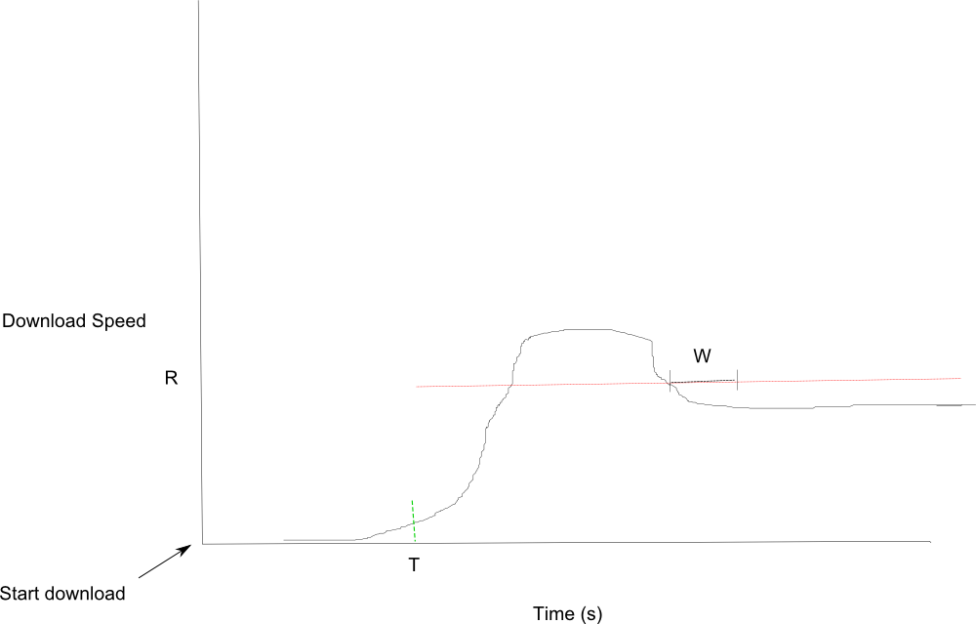
Monitor Download

Slide 17
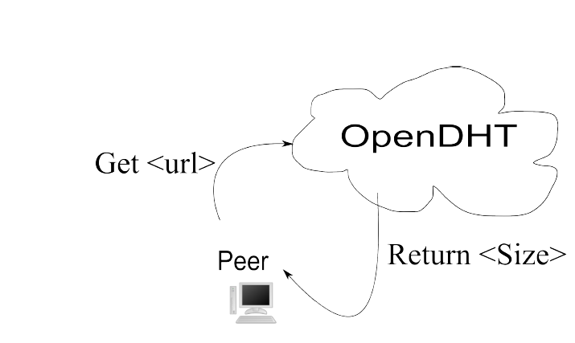
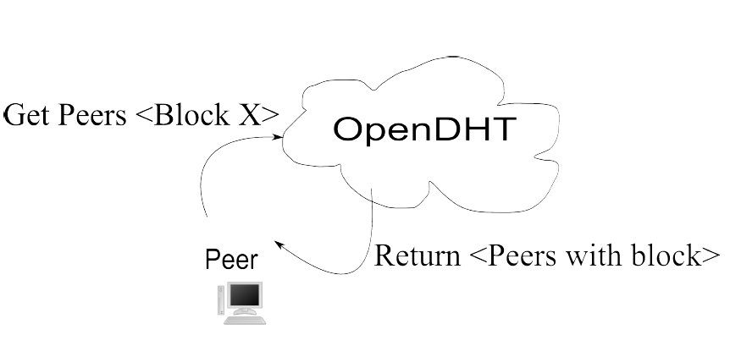
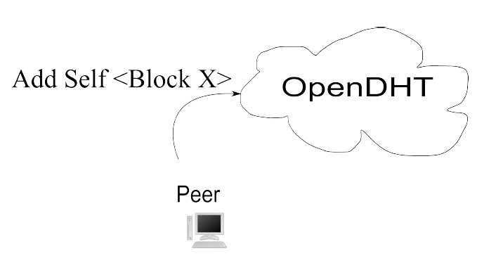
P2P: Transition

Slide 18
Details
T starts immediately.
R is calculated W seconds after T
Private OpenDHT instance.
Redundant DHT keys/gateways.
Polls on lack of peers (1s)
Downloads block from origin
Per block lists.
Last block problem

Slide 19
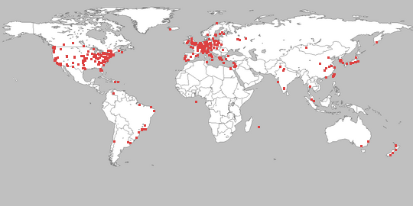
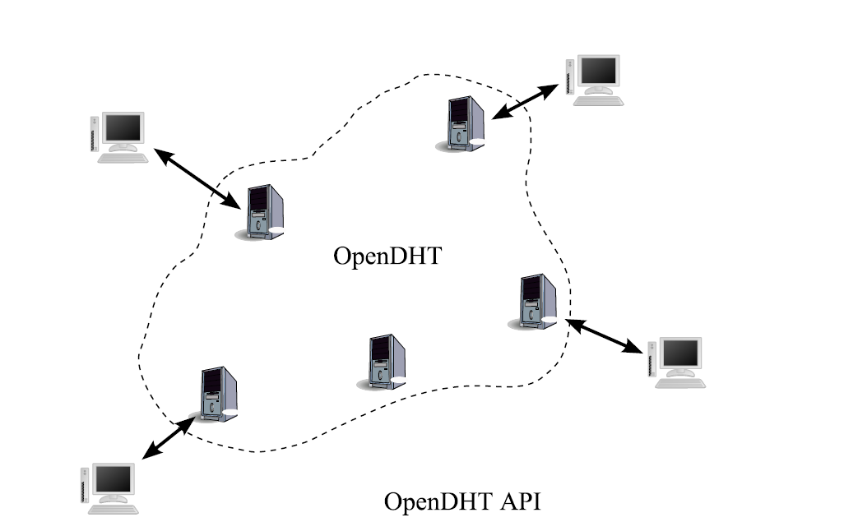
Methodology
PlanetLab
Private OpenDHT

Slide 20

Methodology
Run until finish.
Repeat 3x.
Graph percentiles of:
download times
DHT response times
causes for transitioning to P2P
BYU server
256 KB/s

Slide 21
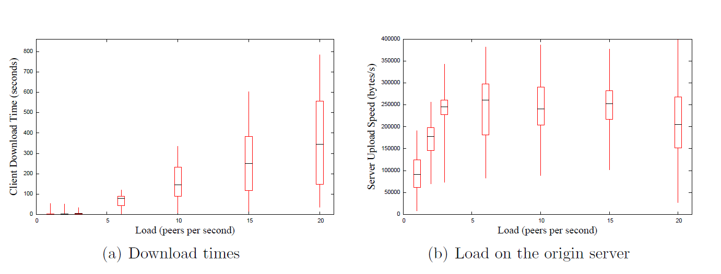
Performance Client-Server
File size: 100 KB, R 128 KB/s, W 2s, T 1s, Linger 60s. Increasing number of startup peers.
Notes:
Note that a semi-popular website might serve half a
million hits a day, which averages to 6 per second, so our limit of 20 per second is similar, if
you take into consideration spikes in load.

Slide 22
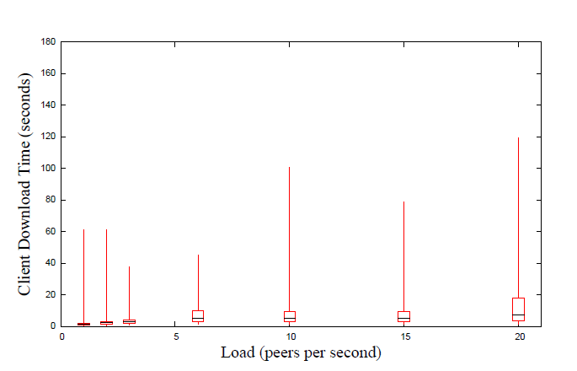
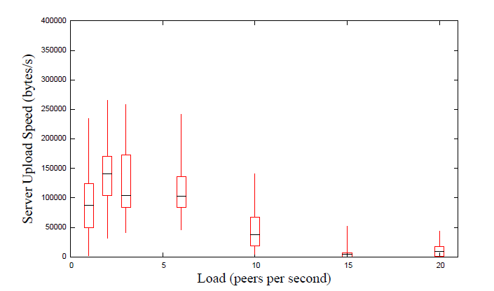
Performance – Automatic Swarming
99.5% transition because of T.
DHT latency of 5.2 seconds.

Slide 23
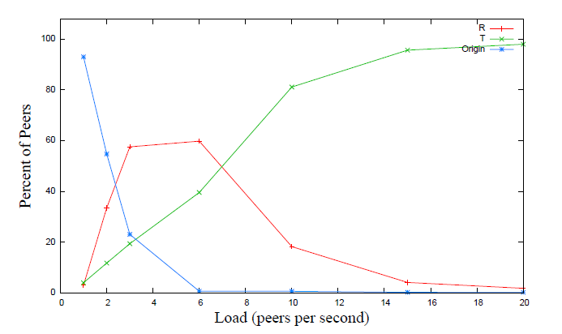
Automatic Swarming Transition Cause

Slide 24
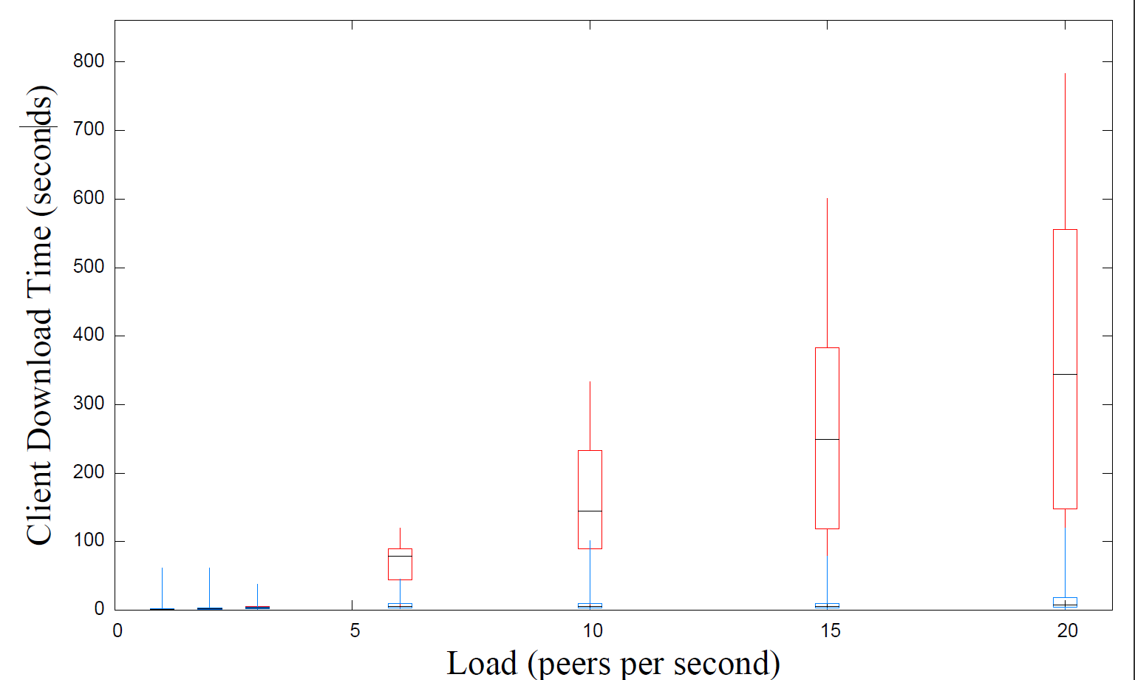
Compared

Slide 25
Effect of Varying Parameters
T, R, W
Multiple Files
Large Files
Block Size
Linger Time
Peer count
1000 peers at 15/second (66 seconds).
100 KB file, 100 KB block size, conn. Limit 5, R 128 KB/s, T 1s, W 2s, Linger 20 s.

Slide 26
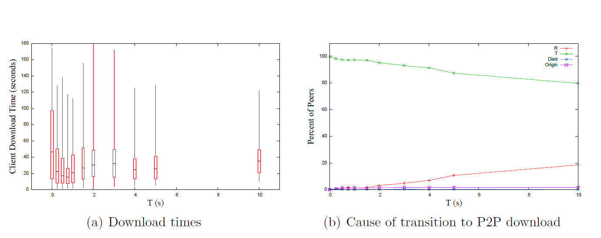
Varying T

Slide 27
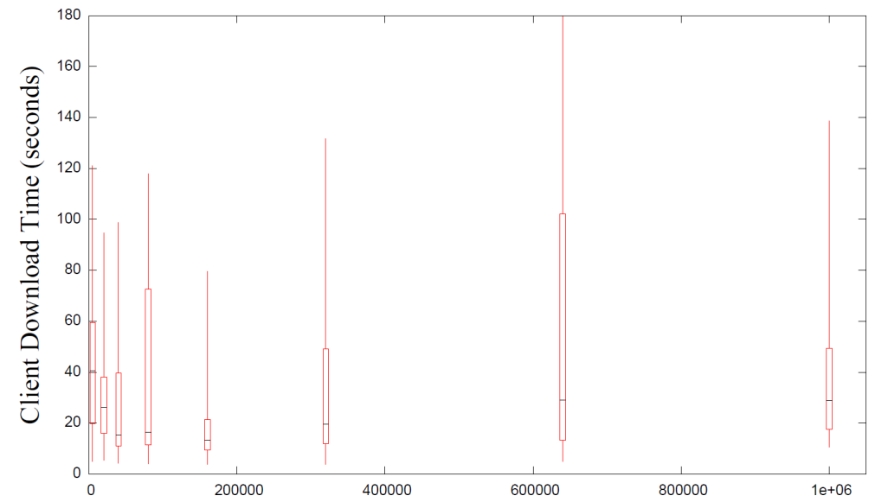
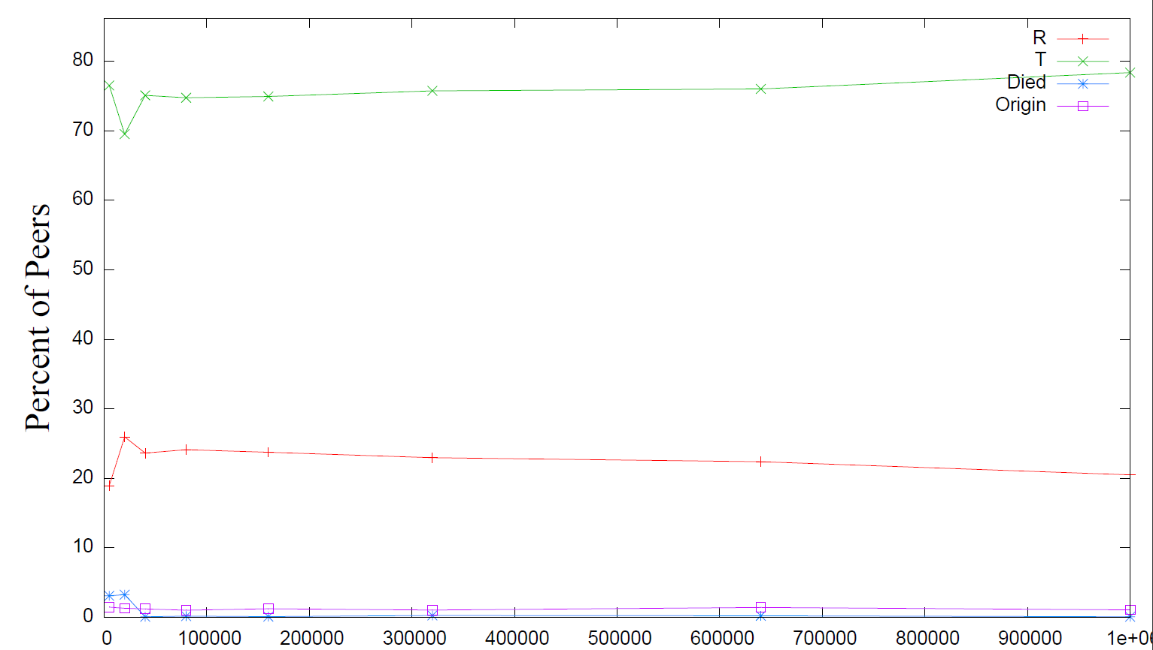
Varying R
Lower is better

Slide 28
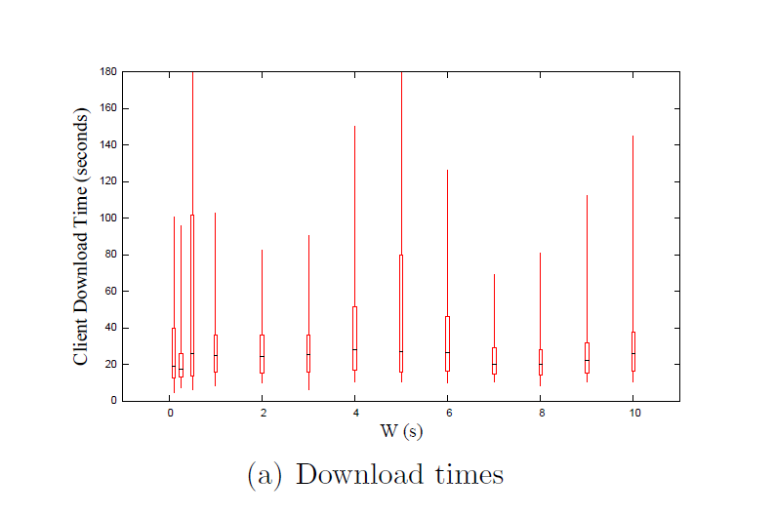
Varying W
Best time was 17 seconds with W at 0.25 seconds.
Rest about 25 seconds.
Lower is better, causes quicker transition, but not much difference.
Notes:
Similar change to R. Because it only affected at most the first few, because after that the server became saturated and T would always fire first.
Probably want that “other” graph in here, too, then, to show “oh it’s all T”?

Slide 29
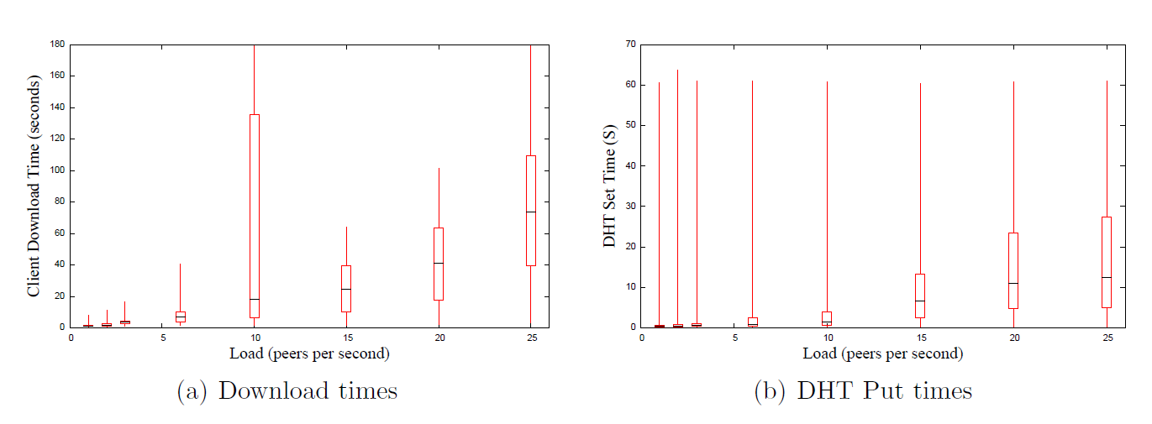
Full web Page
100 KB file, 10 15K files.
10 x as much load on the DHT.
Linger time was set to 20 seconds.
Notes:
Note that our linger time was 20 seconds, so the DHT was becoming less effective under higher load.
This is essentially like 10 times as much load as we were putting on the system before.

Slide 30
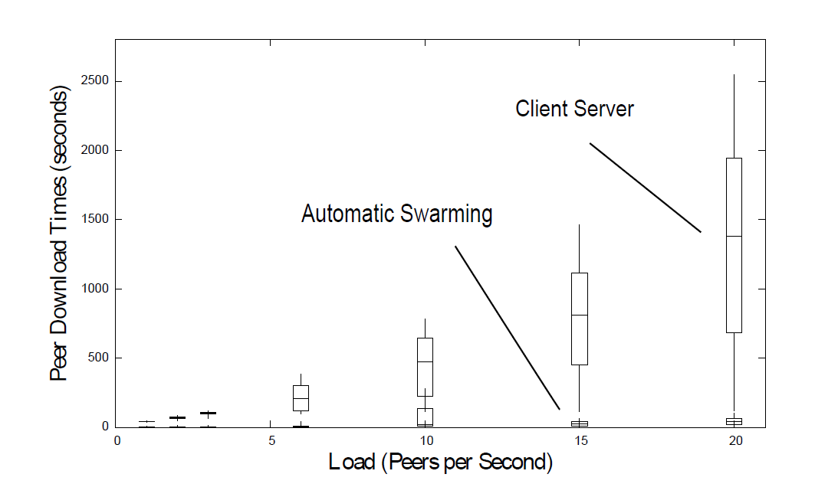
Multiple Files Versus Client-Server

Slide 31
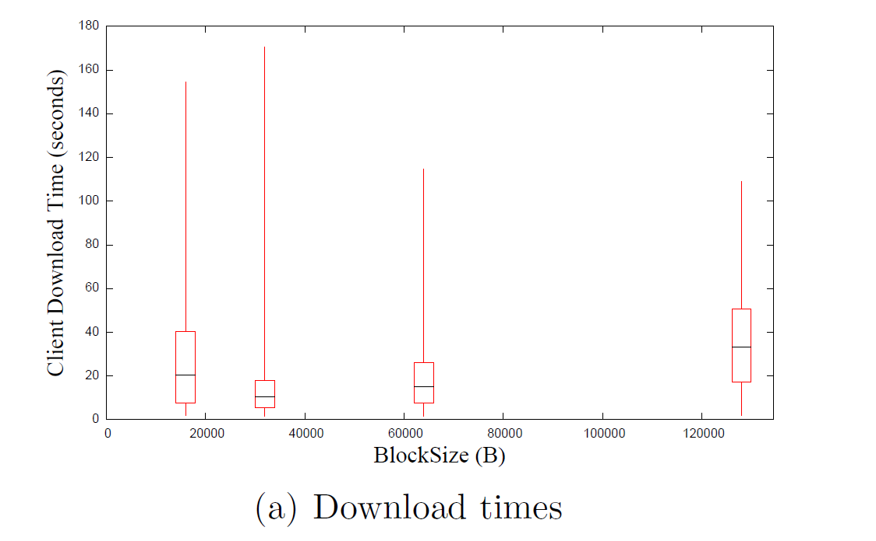
Block Size
10.6 seconds for 32 KB blocks.
Connection limit was 5, so all blocks in parallel.
Notes:
Fastest was 32 KB, presumably because I download from the last few peers in parallel, so this fits best.

Slide 32
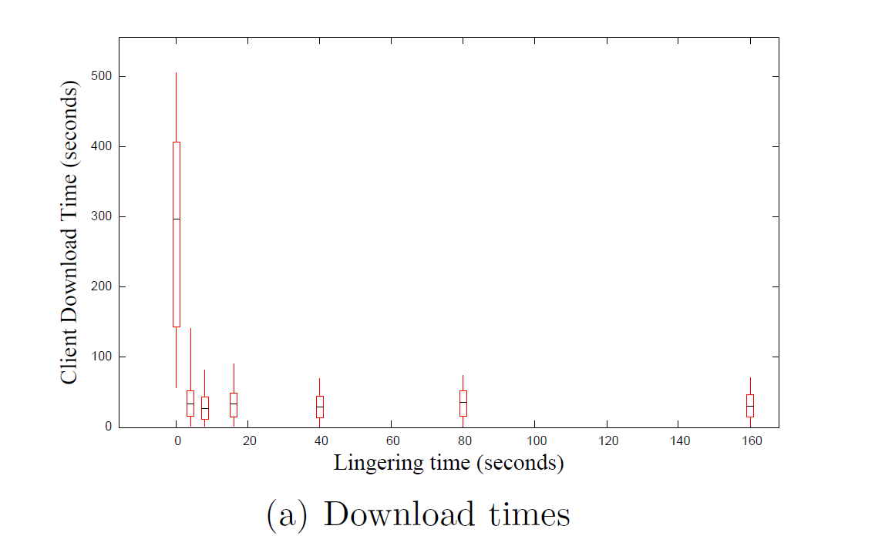
Linger Time

Slide 33
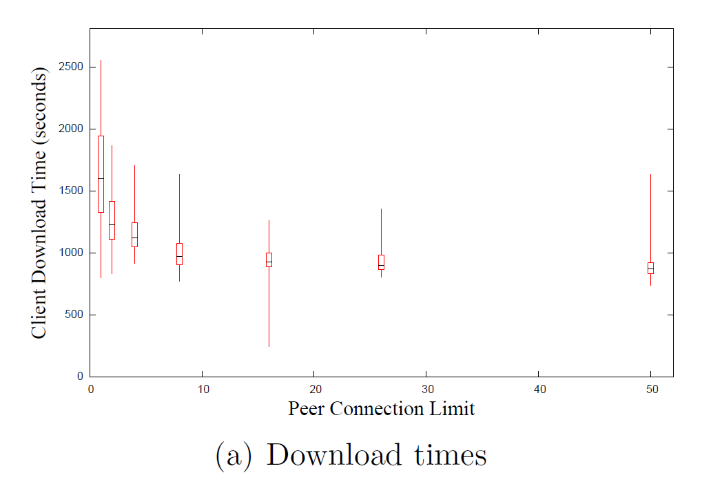
Peer connection
30 MB file.

Slide 34
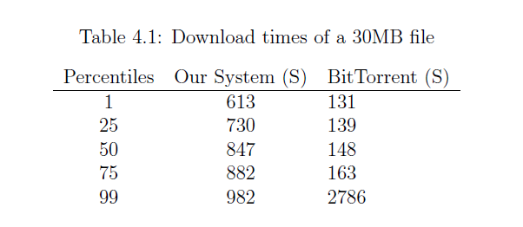
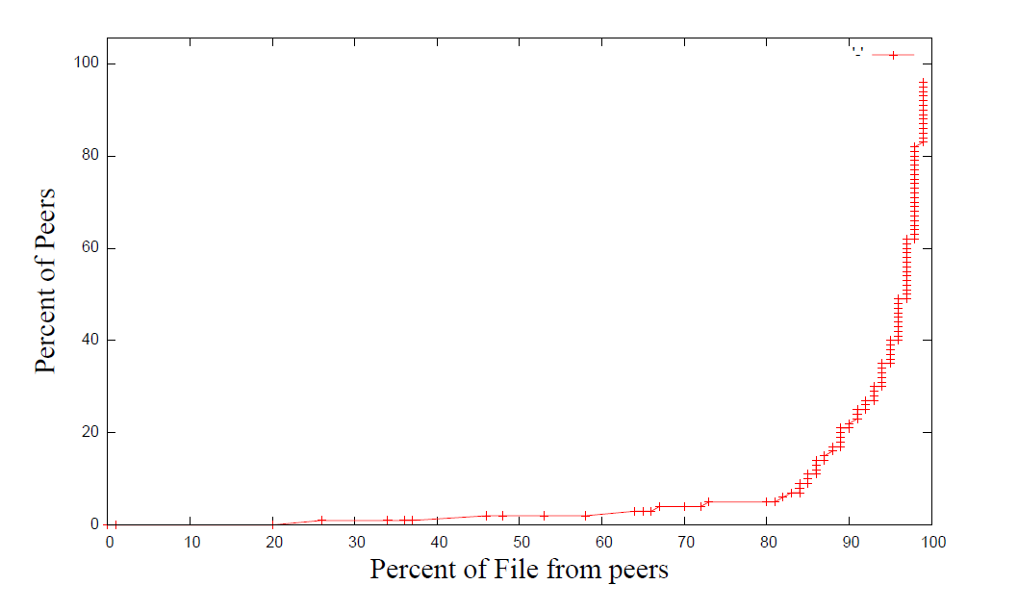
With Large Files
Fast once it gets started for both.
Notes:
“Ours doesn’t perform as well as BT for large files.”
You can see that at about 730 to 882 seconds most of our peers finish the file, and most of the peers download it from peers, so once we get the file out there we work all right, but we could do some work still to increase our speed of propagating the blocks.”

Slide 35
BitTorrent’s Large File Optimizations
Seeds limit outgoing connections.
Favors stronger connections.
Dedicated tracker.
Rarest Block First.
Notes:
We're not entirely sure why BitTorrent is faster.
One factor aecting performance is that BitTorrent's seed limits outgoing connections to
7, whereas Apache's connection limit is 256. This may allow BitTorrent to propagate full
blocks more quickly to peers. BitTorrent's seed also favors peers with higher download
speeds, which may help propagate blocks. In this test, it uses a dedicated tracker, which
makes peer rendezvous quicker than using a DHT. BitTorrent uses a \rarest block rst"
selection policy, enabling it to choose blocks more eciently.

Slide 36
Conclusion
Feasible transition.
Feasible swarming download.
30 x as fast for small files (flash flood).
Backs off server
Make swarming more usable/adoptable
Small files
Non tracked files
Best settings
T: 0.75 s
R: 160 KB/s
32 KB blocks
Peer limit: 16
Linger: 16 s
Notes:
I *wish* I could conclude it worked well for larger files, too, but I guess I can’t say that.

Slide 37
Automatic Swarming -- Goals
Work for any file on any server without configuration.
Easy for client use.
No extra dedicated hardware.
Work for small files.
Non intrusive.

Slide 38
BitTorrent’s failures
Server side.
Per File
Have to provide traditional anyway.
Lack of clients.
Stigma.
Extra maintenance.
Large Files.
Unknown demand.

Slide 39
BitTorrent fails
Clients
Extra setup/time per file.
Small files
Techno intelligencia
Non integrated.
Manual.
Not HTTP optimized.
It should be ignored speed-wise
Duplicate
Costs time
Not available.

Slide 40
BitTorrent can Fail
Not enough seeds.
Closed ports.
Tracker
Extra files.
Users don’t have client installed (chicken/egg).
Clients aren’t configured to use HTTP.

Slide 41


Original slowdown
Notes:
Some sourceforge download
Two proxy instances
One has it
One fresh one that can get it from the other
Download it from the fresh one straight.
Compare speeds.
Better be something big, I suppose.

Slide 42
Future Work
Back off the origin (optimize for large files).
Validate Integrity.
Better use of the DHT.
Fairness
Scalability
Staleness
Dynamic selection of parameters.
Incentives.
Gameable.
Privacy.
Mirrors.
At least as fast as normal.
Notes:
Where immediately effective:
Low bandwidth server.

Slide 43
Other Problems
Still slow.
Differentiate between static/non-static.
Servers CPU bound.
Greedy.
Still has a chicken and egg problem (smaller).
Prefers a slow peer to a medium fast origin.
No intelligent peer selection.
Poor last block.
Notes:
We’re still slow enough for small files that it’s worth it to just wait typically. We could do some more work there.

Slide 44
Questions

